Slide 1
Detection of Phishing Websites Using Machine Learning
Presented By:
Riya Kumari-10900215060
Pooja Priya-10900215052

Slide 2
Content
Introduction
Design
Features of Phishing URL
Dataset
Algorithms Used
Results
Evaluation
Confusion Matrix
Classification Report
Conclusion
References

Slide 3
INTRODUCTION
PHISHING is a social engineering attack that aims at exploiting the weakness found in system processes as caused by system users.
For eg. user leak their passwords if an attacker asked them to update via http link.
Due to the broad nature of the phishing problem, Phishing detection
Was proposed.

Slide 4
DESIGN
Create a UI
User Input
Feature Extraction
URL Classification
Output the results
Evaluation

Slide 5
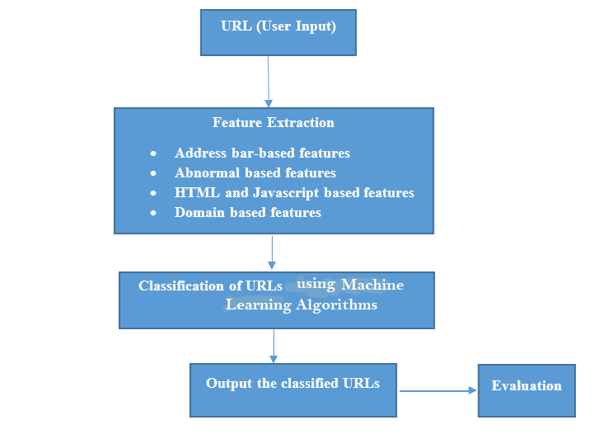

Slide 6
Features of Phishing URL:
Address Bar Based Features
Abnormal Based Features
HTML Based Features
Domain Based Features

Slide 7
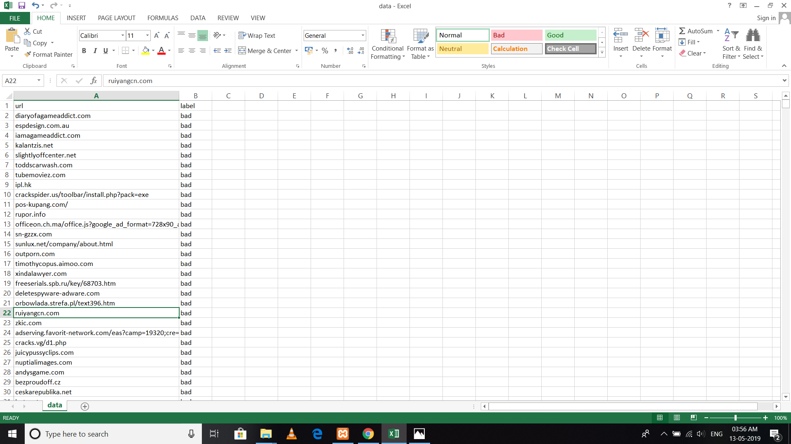
Dataset
We got a dataset from Kaggle containing some good labelled URLs and some bad labelled URLs .

Slide 8
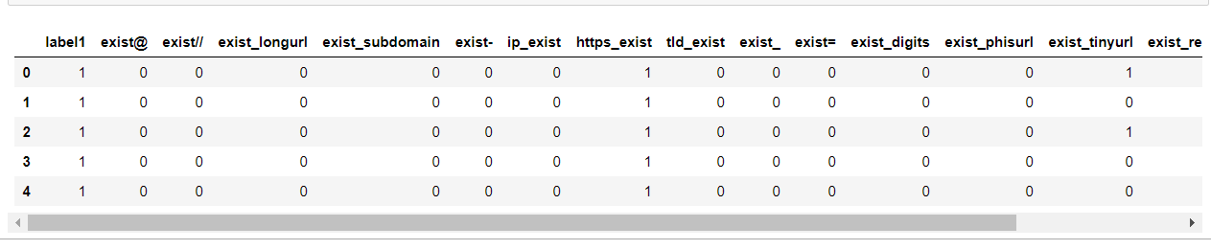
We extracted 15 features using this dataset.

Slide 9
ALGORITHMS USED
1) Random Forest (RF):
The random forest combines hundreds or thousands of decision trees, trains each one on a slightly different set of the observations, splitting nodes in each tree considering a limited number of the features. The final predictions of the random forest are made by averaging the predictions of each individual tree.
2) Naïve Bayes (NB):
It is a classification technique based on Bayes' Theorem with an assumption of independence among predictors. In simple terms, a Naive Bayes classifier assumes that the presence of a particular feature in a class is unrelated to the presence of any other feature.

Slide 10
3) Logistic Regression (LR):
Logistic regression is a statistical method for analyzing a dataset in which there are one or more independent variables that determine an outcome. The outcome is measured with a dichotomous variable (in which there are only two possible outcomes).
4) Decision Tree(DT):
Decision Trees are a type of Supervised Machine Learning (that is you explain what the input is and what the corresponding output is in the training data) where the data is continuously split according to a certain parameter. The tree can be explained by two entities, namely decision nodes and leaves. The leaves are the decisions or the final outcomes. And the decision nodes are where the data is split.

Slide 11
Libraries Used
1)WHOIS 6)socket
2)Pandas 7)datetime
3)sklearn 8)mysql
4)Urllib 9)re
5)tldextract 10)random

Slide 12
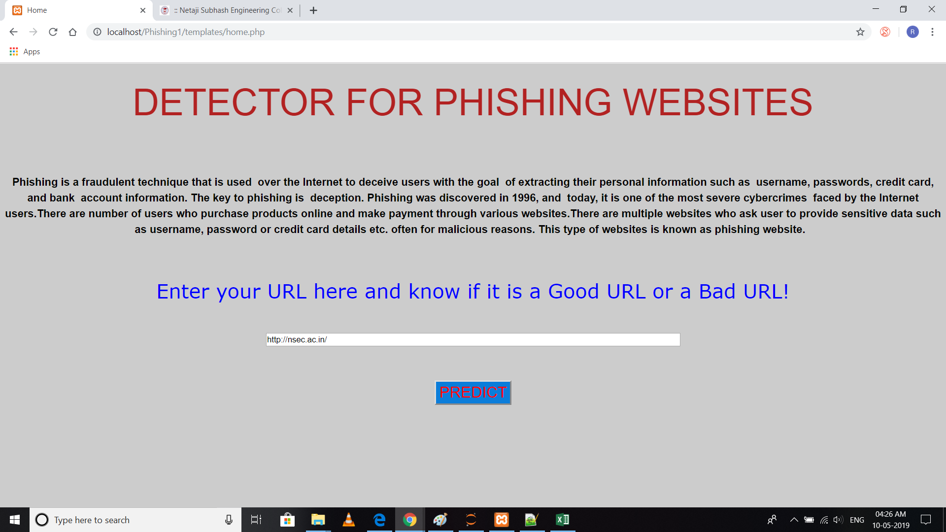
RESULTS
When user enters an URL

Slide 13
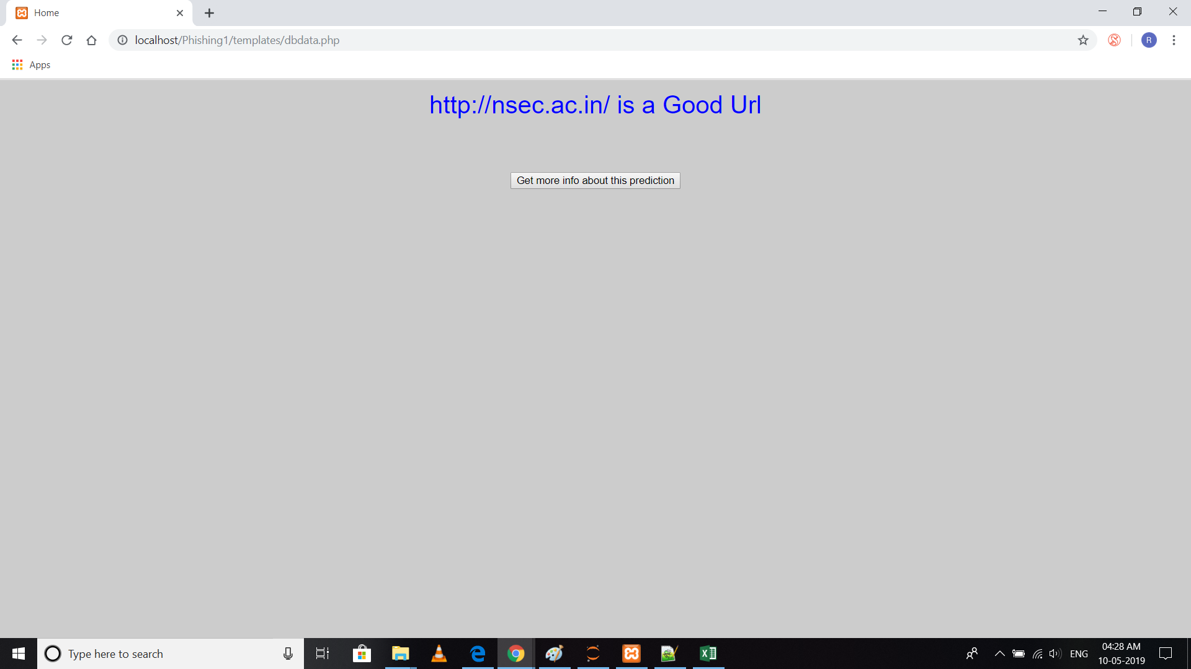
It shows output as :

Slide 14
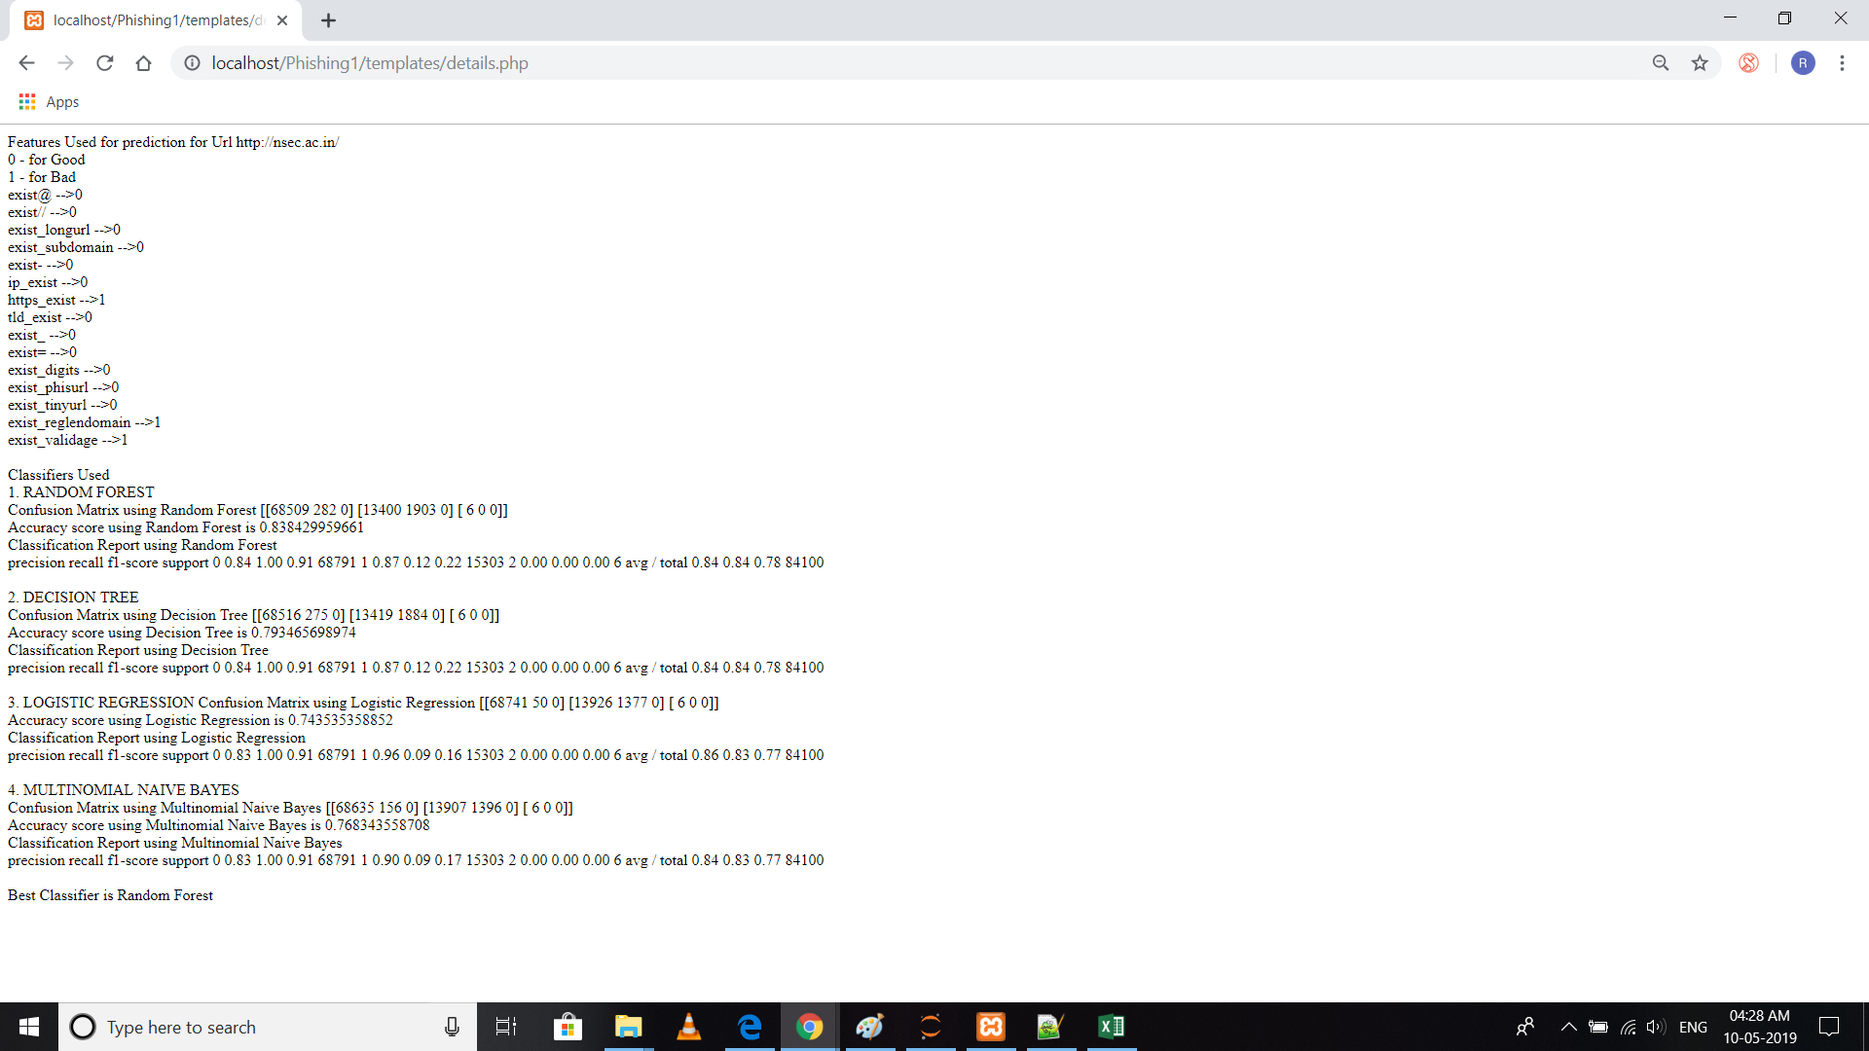
User can also know more about this prediction after clicking on button “Get more info about this prediction” to know about classifiers used ,accuracy scores and classification Report.

Slide 15
EVALUATION
ACCURACY SCORES:
CLASSIFICATION | ACCURACY(%)
Random Forest | 83.84
Logistic regression | 74.35
Decision Tree | 79.34
Naive Bayes | 76.83

Slide 16
CONFUSION MATRIX:
In the field of machine learning and specifically the problem of statistical classification, a confusion matrix, also known as an error matrix.
A confusion matrix is a table that is often used to describe the performance of a classification model (or “classifier”) on a set of test data for which the true values are known. It allows the visualization of the performance of an algorithm.
It allows easy identification of confusion between classes e.g. one class is commonly mislabeled as the other. Most performance measures are computed from the confusion matrix.

Slide 17


The confusion matrix using Random Forest is:
The confusion matrix using Decision Tree is:

Slide 18


The confusion matrix using Logistic Regression is:
The confusion matrix using Naive Bayes is:

Slide 19
CLassification Report
The classification report shows a representation of the main classification metrics on a per-class basis. This gives a deeper intuition of the classifier behavior over global accuracy which can mask functional weaknesses in one class of a multiclass problem.
The metrics are defined in terms of true and false positives, and true and false negatives.
Precision
Precision is the ability of a classiifer not to label an instance positive that is actually negative.
Recall
Recall is the ability of a classifier to find all positive instances.

Slide 20
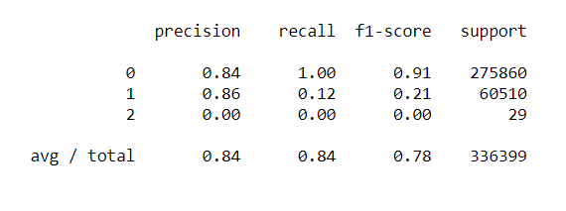
F1 score
The F1 score is a weighted harmonic mean of precision and recall such that the best score is 1.0 and the worst is 0.0.
Support
Support is the number of actual occurrences of the class in the specified dataset.
The classification report using Random Forest:

Slide 21
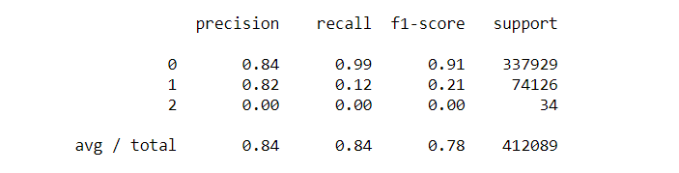
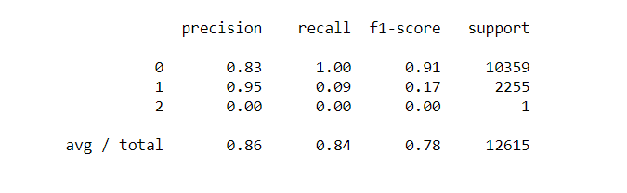
The classification report using Decision Tree:
The classification report using Logistic Regression:
The classification report using Naive Bayes:

Slide 22
CONCLUSION
Phishing is a cyber crime procedure utilizing both social building and specialized deception to take individual sensitive data. Besides, Phishing is considered as another extensive type of fraud. Experimentations against recent dependable phishing data sets utilizing different classification algorithm have been performed which received different learning methods. The base of the experiments is accuracy measure. The aim of this project work is to predict whether a given URL is phishing website or not. It turns out in the given experiment that Random forest based classifiers are the best classifier with great classification accuracy of 83.84% for the given dataset of phishing site. As a future work we might use this model to other Phishing dataset with larger size then now and then testing the performance of those classification algorithms in terms of classification accuracy.

Slide 23
REFERENCES
https://nevonprojects.com/detecting-phishing-websites-using-machine-learning/.
https://jis-eurasipjournals.springeropen.com/articles/10.1186/s13635-016-0034-3
G. Aaron and R. Rasmussen, “Global phishing survey: Trends and domain name use in 2016,” 2016, http://docs.apwg.org/reports/ APWG_Global_Phishing_Report_2015-2016.pdf
UCI Machine Learning Repository.” http://archive.ics.uci.edu/ml/, 2012.
P. Tiwari, R. Singh International Journal of Engineering Research & Technology (IJERT) ISSN: 2278-0181Vol. 4 Issue 12, December-2015.

Slide 24
THANK YOU!!

